Slide 1
AASHTO T288 Determining Minimum Laboratory Soil Resistivity
Procedures utilized by the Central Laboratory
11/04/2021

Slide 2
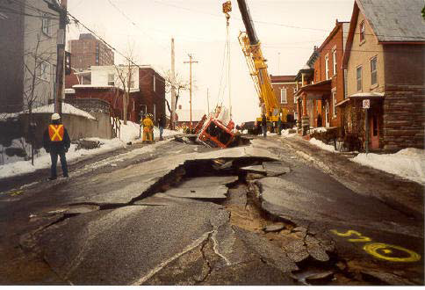
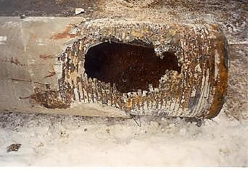
Why test for soil corrosion?
B.
A.
C.
Notes:
READ: Why test for soil Corrosion? ….because many structures and much of our utilities’ infrastructure is buried in the soil we walk on everyday. If the soil is corrosive, it can damage our utilities’ infrastructure and cause structural failure.
Picture A. Damage caused by the release of pressurized water, from a corroded water main. Note the fire truck that came to the rescue.
Picture B. After the Fire truck was removed.
Picture C. Corroded water main….the cause of all the damage!

Slide 3
Outline
Soil Corrosion.
Soil Resistivity Information
Corrosivity Ratings.
AASHTO T288 scope.
Sample Preparation.
Determining Minimum Laboratory Soil Resistivity.
Views of sample consistencies after each water addition.
Results and Reporting.
MoDOT Contact Information.
Notes:
READ: This is the outline for this presentation….

Slide 4
SOIL CORROSION
What causes CORROSION in soils?
pH (acidity) - Soils can have a wide range of acidity, reaching anywhere from 2.5 to 10. As pH levels of 5 or below can lead to extreme corrosion rates and premature pitting of metallic objects, a neutral pH of about 7 is most desirable to minimize this potential for damage.
Sulfate and Sulfides - Sulfates can attack concrete and chemically change the binding compounds causing expansion, cracking, and loss of strength. If you have ever seen a white powdery substance on a concrete surface you have probably seen evidence of a sulfate attack.
Chlorides - Chloride can destroy the stable layers of protection that can naturally form on the surfaces of some metals, exposing the unprotected metal to further corrosion. In reinforced concrete structures, chloride can migrate through the concrete causing the rebar to begin corroding and swelling, subsequently causing the surrounding concrete to crack and break apart.
Moisture Content & Resistivity – Moisture content is a more important factor in soil corrosivity than any other variable. As water is one of the three components necessary for electrochemical corrosion (the other two being oxygen and metal), corrosion will not occur if the soil is completely dry.
Experimental evidence dictates that an increased moisture content decreases resistivity of soils, in turn increasing their corrosive potential. Note that when the saturation point of the soil is reached, additional moisture has little or no effect on resistivity.
Notes:
READ: There are several factors that cause soil corrosion, pH (acidity), Sulfate and Sulfides, Chlorides, and the most important factor in soil corrosivity is Moisture Content & Resistivity.
NOTE: In the lab we test Soil Resistivity using AASHTO T288.

Slide 5
Soil Resistivity Information
Soil resistivity is a measure of how easy it is for electrons to flow in the soil.
Corrosion reactions will proceed more easily when the resistance to electron flow is lower and proceeds more slowly in soils with a high resistivity.
Soil resistivity is affected by both the amount of dissolved solids (salts) in the soil, as well as, the moisture content of the soil. The more dissolved solids present in the soil, the lower the resistivity will tend to be.
The resistivity of a dry soil will tend to be very high. As the moisture content increases, the resistivity will drop. As the soil approaches saturation the resistivity will reach a minimum (this the worst-case condition).
Further increases in moisture content will result in an increase in resistivity as the dissolved solids begin to be diluted by the water. The most conservative measure of resistivity is the 100% saturated resistivity
(or minimum resistivity).

Slide 6
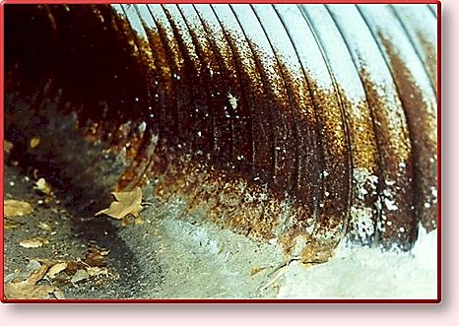
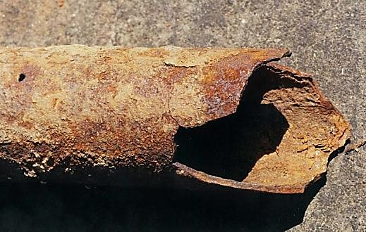
Soil Resistivity
Greater Resistivity = Less Current Flow
Less Current Flow = Lower Corrosion!

Slide 7
Corrosivity Ratings Based On Soil Resistivity
Soil resistivity is a function of soil moisture and the
concentrations of ionic soluble salts and is considered
to be most comprehensive indicator of a soil’s corrosivity.
Typically, the lower the resistivity, the higher will be the
Corrosivity as indicated in the following Table.
Soil Resistivity (ohm cm) | Corrosivity Rating
> 20,000 | Essentially non-corrosive
10,000 to 20,000 | Mildly corrosive
5,000 to 10,000 | Moderately corrosive
3,000 to 5,000 | Corrosive
1,000 to 3,000 | Highly corrosive
< 1,000 | Extremely corrosive
Notes:
INFORMATION :
Since ionic current flow is associated with soil corrosion reactions, high soil resistivity will arguable slow down corrosion reactions.
Soil resistivity generally decreases with increasing water content and the concentration of ionic species.
Sandy soils are high up on the resistivity scale and therefore considered the least corrosive.
Clay soils, especially those contaminated with saline water are on the opposite end of the spectrum.

Slide 8
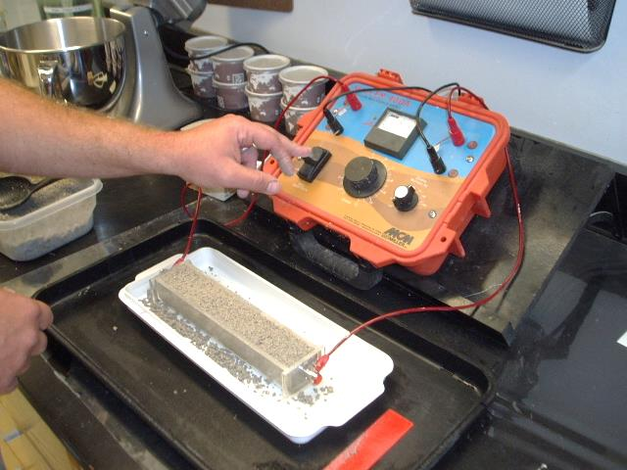
AASHTO T288
SCOPE
This test method covers the laboratory determination for the minimum resistivity of a soil sample.
The principal use of this test method is to determine a soil’s corrosivity and thereby identify the conditions under which the corrosion of the metals in soil may be sharply accentuated.
Notes:
T288 (NOTE 1): When less than 5% of a material passes the No. 10 sieve, this test method may not be indicative of the corrosion potential of the material.

Slide 9
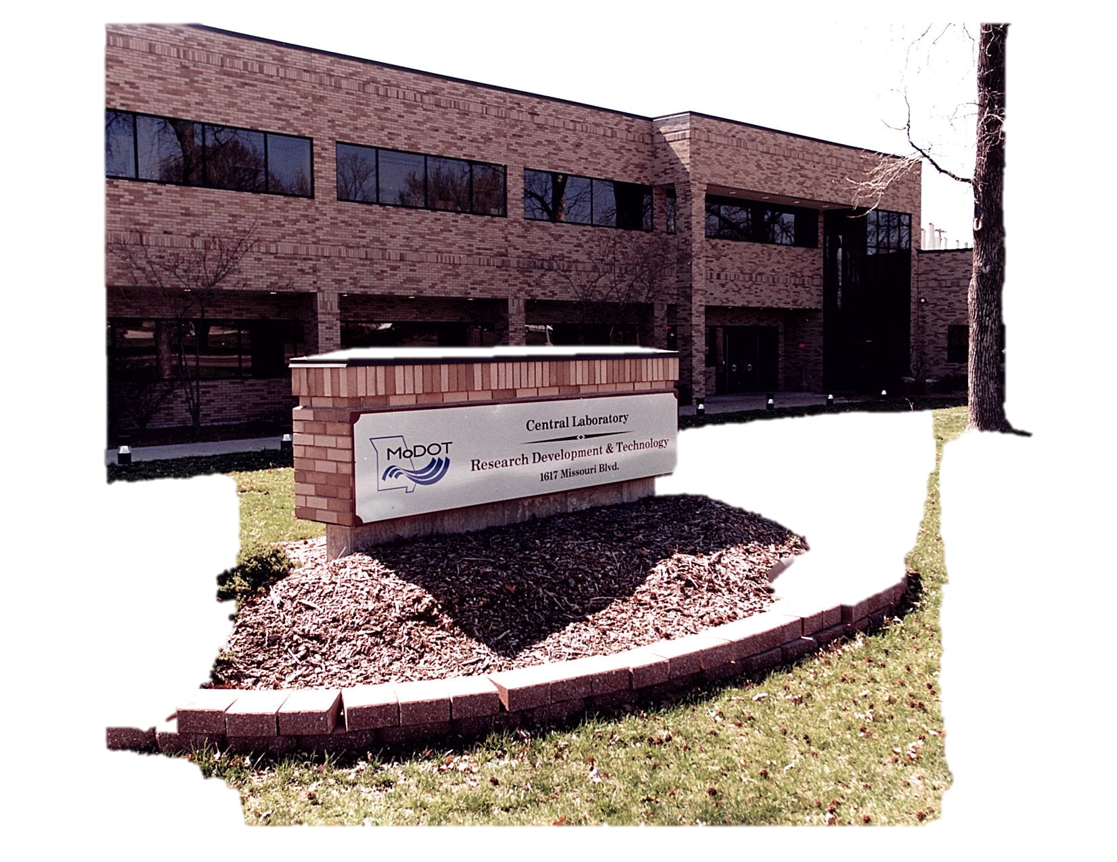
Let’s Get Started….
What’s the blue
stuff in the flask?
Notes:
Let’s get started AASHTO T288…

Slide 10
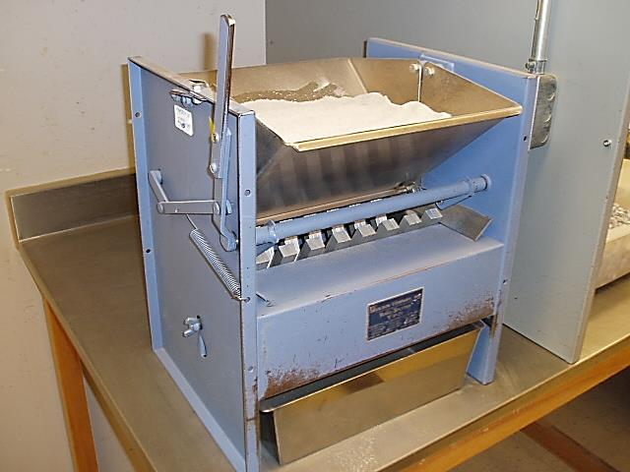
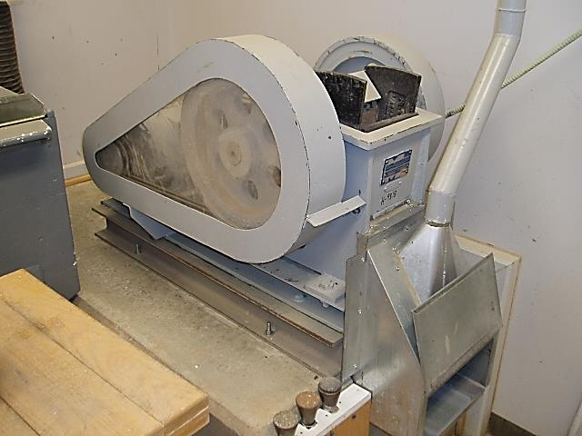
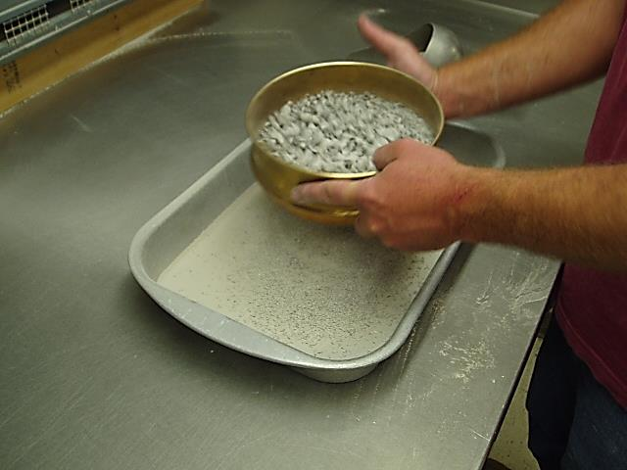
SAMPLE
PREPERATION
Notes:
Before we can test the soil, we will have to prepare it.

Slide 11
Sample Preparation Summary
1. | Equipment Needed.
2. | Reducing Field Samples using AASHTO T248.
3. | Drying the Field Sample at a temperature not exceeding 60ºC (140ºF).
4. | Separating the Field Sample by utilizing the appropriate Method (A, B, or C).
5. | Using Method A (MoDOT).
6. | Collect a representative sample of (~ 1500 grams) finer than No. 10 sieve.

Slide 12
Equipment Needed for preparing the soil sample
Balance: Readable to 0.1 percent or better and sufficient capacity of the sample mass, conforming to AASHTO M231.
Drying Apparatus: Any suitable device capable of drying samples at 60ºC (140ºF).
Sieves: A series of the following sizes: 6.30mm (¼ inch)
4.75mm (No. 4)
2.00mm (No. 10)
and Pan.
Pulverizing Apparatus: Either a mortar and Rubber-covered pestle or any device suitable for breaking up aggregates according to T 288.
Sample Splitter: A suitable riffle sampler or sample splitter for proportional splitting of the sample and capable of obtaining representative portions of the sample without appreciable loss of fines. A canvas cloth is also permitted.

Slide 13
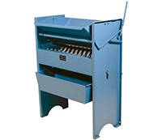
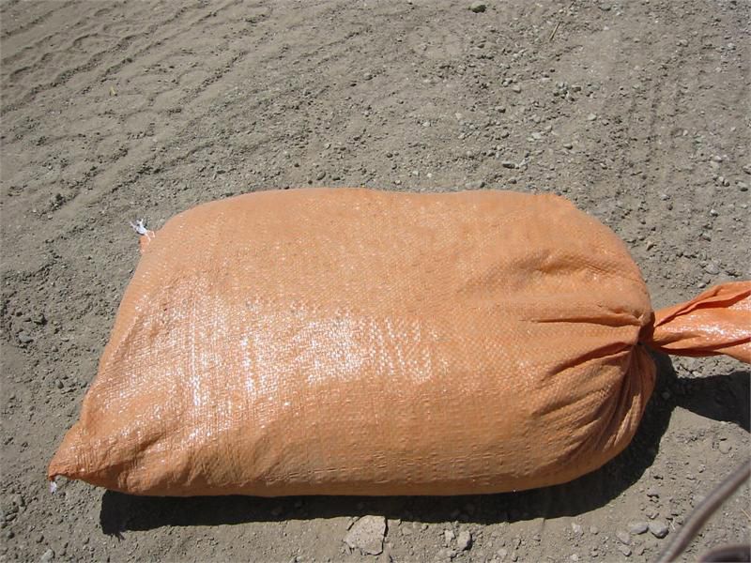
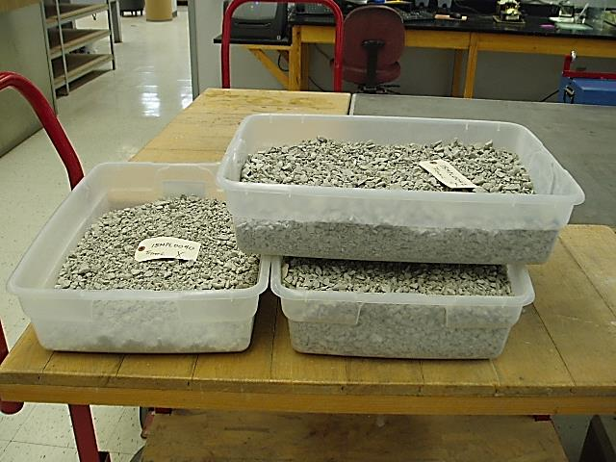
AASHTO T248 Reducing Field Samples Down to Testing Size
NOTE
Sample must be large
Enough to yield at least
1500 grams of dry soil finer
than a No.10 sieve after
processing.
Notes:
We start with three 45-55 pound bags of field sample.
Then it’s reduced to testing size accordingly to AASHTO T248 using a splitter, and a representative sample is placed in a plastic tub.
The plastic tub in this picture is holding about 35 pounds (15,000 to 20,000 grams).
Plastic Tub Size: 28 quart, Dimensions are 23½” L X 16 7/8” W X 5 7/8”H. (You can buy one at Walmart) LOL!

Slide 14
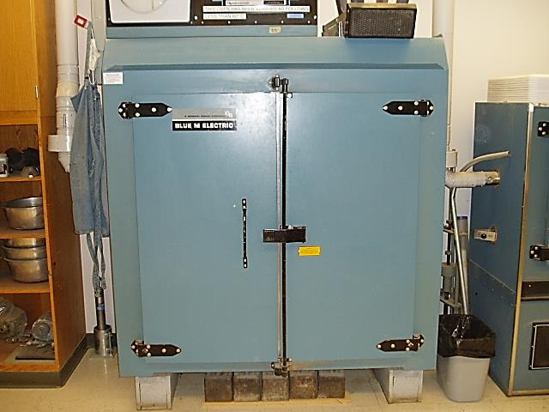
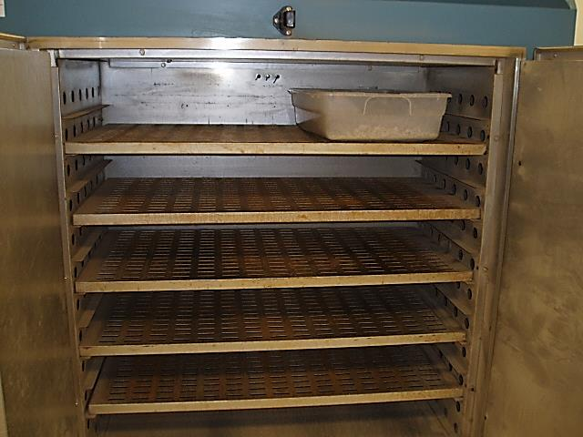
Air Drying Field Samples Using an Oven set at 60C (140°F)
Plastic Tub
Notes:
After reducing the field sample, it is then air dried overnight in a 60ºC oven. (About 12-14 hours)
AASHTO T288: States that the sample as received from the field shall be dried in air or a drying apparatus not exceeding 60C (140F).

Slide 15
Separation Methods
THREE METHODS TO CHOOSE FROM
A. Alternate Method Using the No.10 Sieve. (2.0mm)
B. Alternate Method Using No. 4 and No.10 Sieves. (4.75-mm and 2.00mm)
C. Alternate Method Using ¼” and No. 10 Sieves. (6.3mm and 2.00mm)
Notes:
AASHTO T288: The portion of the dried sample selected for minimum soil resistivity testing shall be separated into fractions
by one of the following methods….A, B, or C
We use Method #A.

Slide 16
“Method A”
Alternate Method Using No.10 Sieve
Separate the dried sample into two fractions using a No.10 sieve.
The fraction retained on the No. 10 sieve shall be ground with a pulverizing apparatus until the aggregations of the soil particles are broken into separate grains.
After pulverizing, the material is then separated into two fractions over a No. 10 sieve.
Collect approximately 1500 grams of the sample passing the No. 10 sieve for testing.

Slide 17
“Method B”
Alternate Method Using No 4 and No.10 Sieves
Separate the dried sample into two fractions using a No. 4 sieve.
The fraction retained on the No. 4 sieve shall be ground with a pulverizing apparatus until the aggregations of the soil particles are broken into separate grains.
After pulverizing, the material is then separated again into two fractions over a No. 4 sieve.
The fraction passing the No. 4 sieve shall be mixed thoroughly using a splitter or by splitting and quartering, using a representative portion adequate for testing.
This split-off a portion shall then be separated using the No. 10 sieve, and then prepared according to Method A.

Slide 18
“Method C”
Alternate Method Using ¼ inch sieve and No.10 Sieve
Separate the dried sample into two fractions using a ¼ inch sieve.
The fraction retained on the ¼ inch sieve shall be ground with a pulverizing apparatus until the aggregations of the soil particles are broken into separate grains.
Again Separate the sample into two fractions using a ¼ inch sieve.
The fraction passing the ¼ inch sieve shall be mixed using a splitter or by splitting and quartering.
A representative portion adequate for testing shall be obtained.
The split off portion shall then be separated on the No. 10 sieve, and prepared according to Method A.

Slide 19
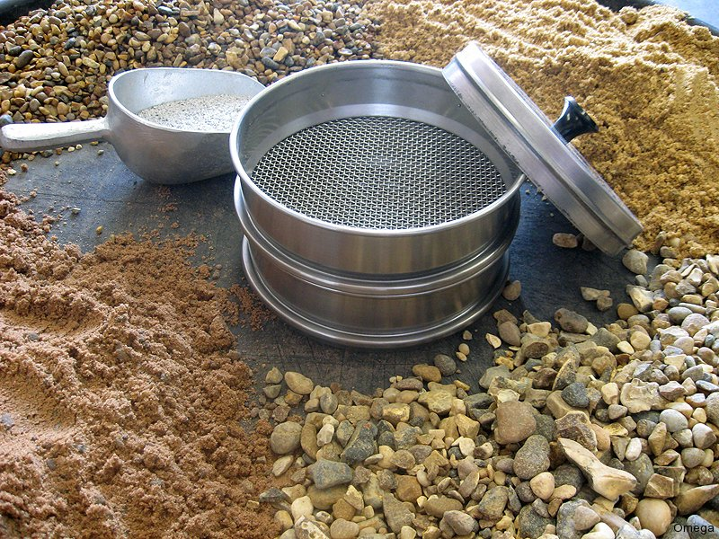
REVIEW METHOD “A”
Notes:
We use method “A” is used most of the time.

Slide 20
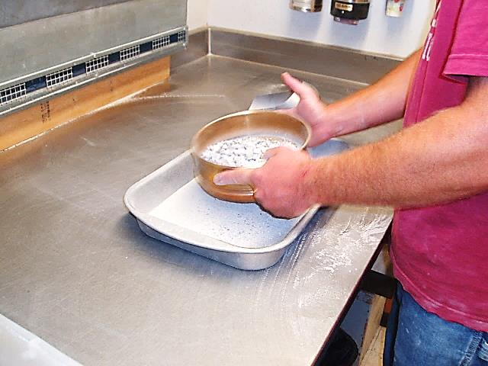
“Method A”
1st Separation Using a No. 10 Sieve
Keep retained
Notes:
In Method “A” the field sample is separated by sieving using a No. 10 sieve keeping the retained material for pulverizing.

Slide 21
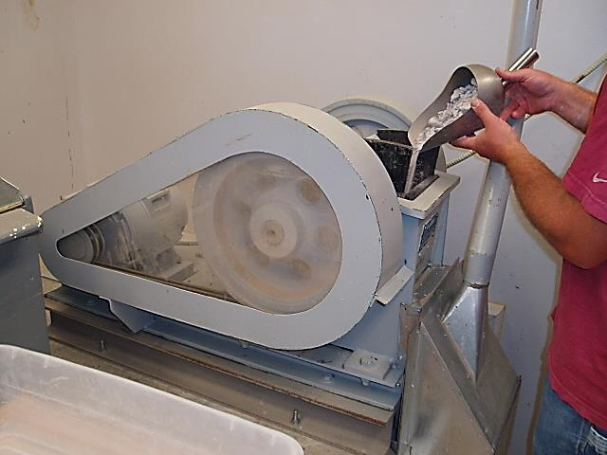
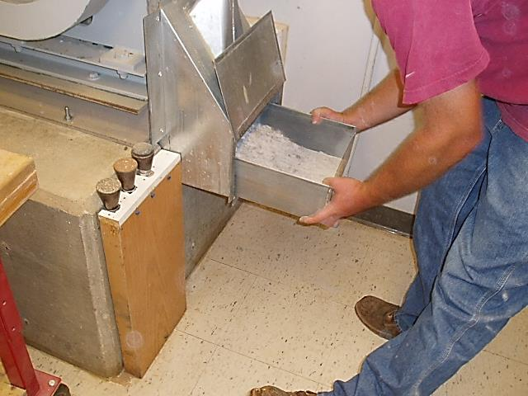
Crushing & Pulverizing
Crush and Pulverize what was retained on the No.10 sieve
Notes:
Pulverize enough to have 1500g of material that will pass a No. 10 Sieve.
AASHTO: The fraction retained on the No 10 sieve shall be ground with a pulverizing apparatus until the aggregations of soil particles are broken into separate grains.

Slide 22
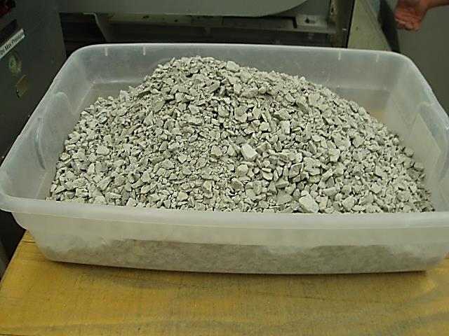
Before and After Crushing & Pulverizing
Before: Original Sample Size
After: Crushed Sample
Notes:
The tubs in these pictures have approximately 15,000 to 20,000 grams or 35 pounds of sample in them.

Slide 23
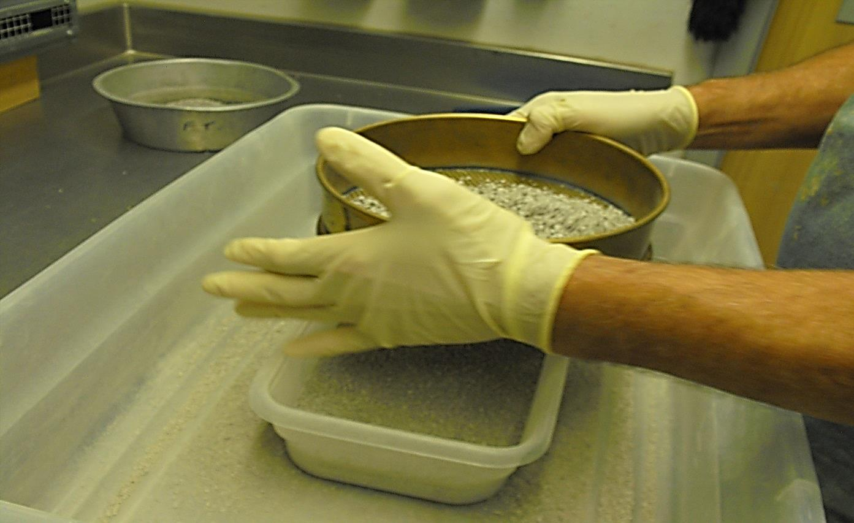
2nd Separation Using a No. 10 Sieve
Sieve the crushed soil until you have at least 1500 grams of material passing the No.10 sieve.
Notes:
MODOT will Sieve an extra 300 grams for three Chemical Tests
pH AASHTO T289 (we check this every time)
2. Chlorides AASHTO T291 (test only if the Resistivity reading is over 5,000 )
3. Sulfates AASHTO T290 (test only if the Resistivity reading is over 5,000 )

Slide 24
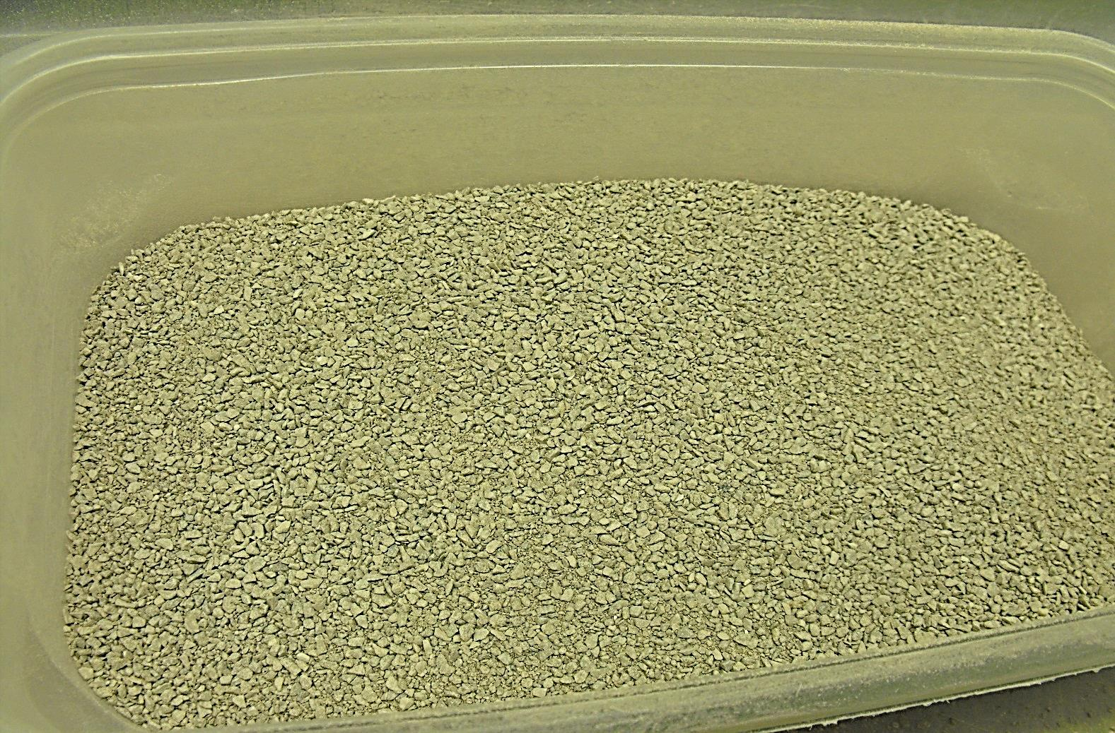
Separated Fraction Ready for Testing.

Slide 25
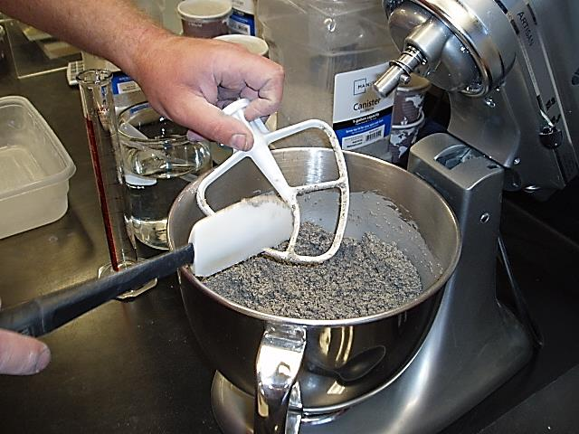
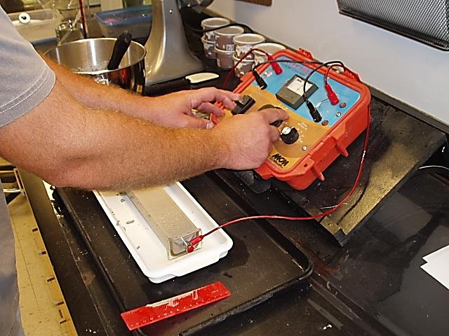
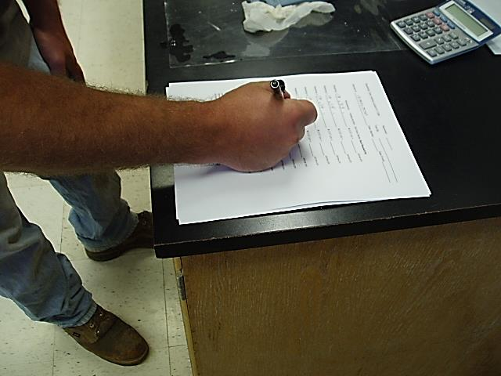
DETERMINING MINIMUM LABORATORY SOILRESISTIVITY…

Slide 26
Resistivity Testing Summary
1. | Equipment Needed
2. | Information on Supplies and Equipment
3. | Calculating the Constant Multiplier.
4. | Two Point Connection.
5. | Calibrating the Resistivity Meter.
6. | Soil Resistivity Procedure, in 14 Steps.
7. | Determining the Minimum Resistivity

Slide 27
Equipment Needed
For
Resistivity Determination.
Resistivity Meter: An alternating current (AC) meter or a 12-volt direct current (DC) meter utilizing a Wien Bridge (AC bridge) with a phase sensitive detector and a square wave inverter that produces a nominal alternating signal at 97Hz.
Ohm Resistors: 100-, 200-, 500-, and 900-ohm resistors with a 1% tolerance.
Soil Box
Sieve: 2.00mm (No.10) Sieve conforming to the requirements of M92.
Mixing Pans: Noncorrosive; e.g., stainless steel, plastic, etc.)
Graduated Cylinder: 100-mL capacity.
Distilled water or Deionized water
Straightedge: 305mm (12 inches) in length
Mixer with Mixing Bowl, Spatulas and Spoons. (noncorrosive)

Slide 28
Mixing Equipment
Non Corrosive Equipment
Stainless Steel
Plastic
Mixer & Bowl
Over flow tray.
Spoons and spatulas
Mixing paddle
Large Soil Box

Slide 29
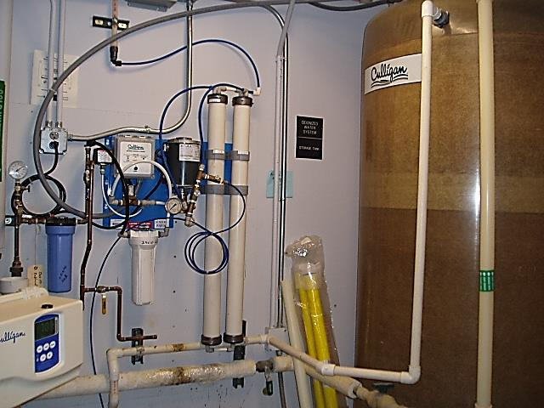
DI Water Source
DI = Deionized

Slide 30
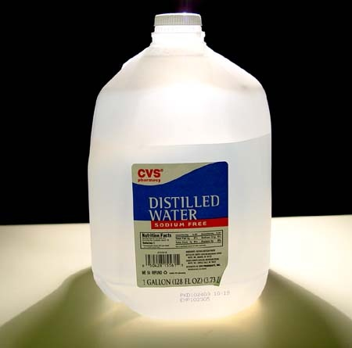
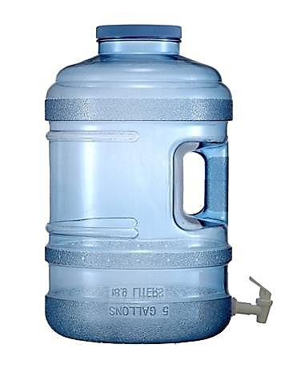
Distilled Water Source

Slide 31
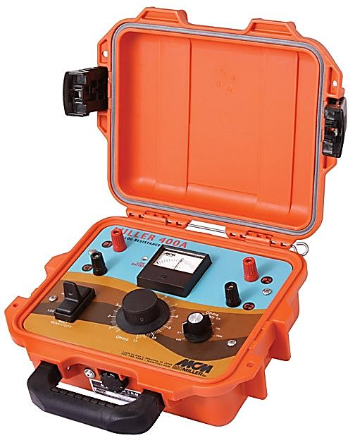
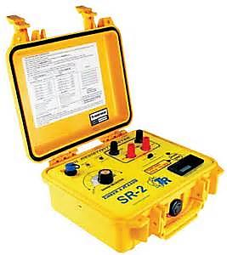
RESISTANCE METERS
Miller 400A
SR-2 Tinker & Rasor
Notes:
T288 Meters: An alternating current (AC) meter or a 12-volt direct current (DC) meter utilizing a Wien Bridge (AC bridge) with a phase sensitive detector and a square wave inverter that produces a nominal alternating signal at 97Hz.
MODOT: Uses a MCM Miller 400A Meter

Slide 32
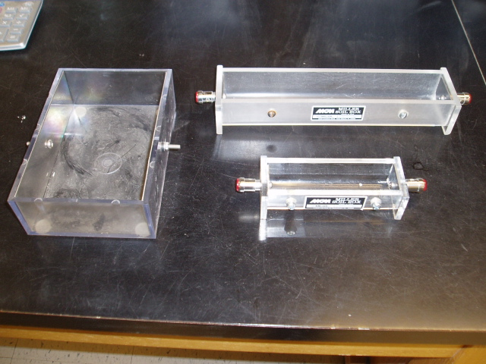
Different Sized Soil Boxes
A.
Large Soil Box A/L = 0.57cm
Soil Box A/L = 6.67cm
B.
C.
Small Soil Box A/L = 0.67cm
The multiplying constant is derived as follows:
A/L =
Surface Area of One Electrode (cm²)_________________
Measured Average Distance between Electrodes (cm) = cm² = cm
cm
Notes:
Soil boxes may be constructed of either 6.4 or 12.7mm (¼ or ½ inch) acrylic plastic.
If other size soil boxes are used, it will be necessary to determine the correct multiplier.
It should also be noted that it may be necessary to prepare extra soil for testing to fill the larger soil boxes.

Slide 33
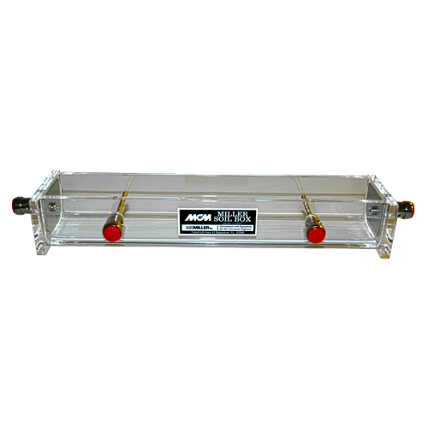
Calculating the Constant Multiplier
Large Soil Box :
Cross-sectional area (A) = 3cm x 2.4cm = 7.2cm²
Interior pin separation (L) = 7.2cm A/L = 1 cm
So, for the Large Soil Box the multiplier is :
A/L = 12.8 square cm / 22.2cm = 0.57cm
For the 2-electrode method, the two interior pins are removed which changes the multiplication factor from 1cm (for the 4-electrode method) to either 0.67cm for the small box or to 0.57cm for the large box. Please see the following link for details:

Slide 34
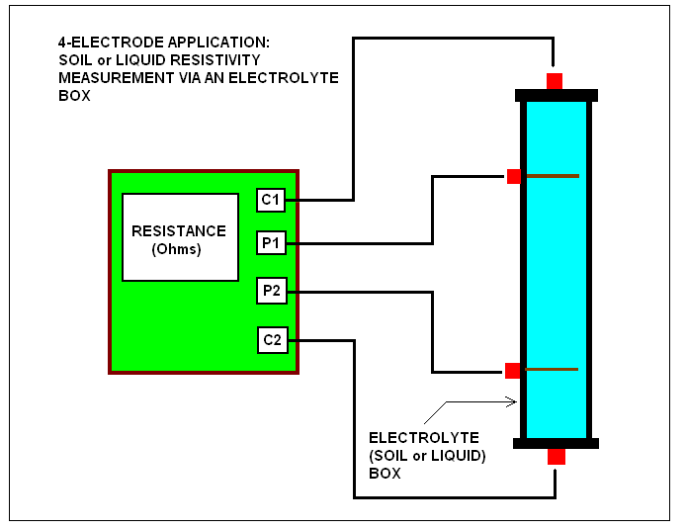
Two Point Connection to a Soil Box
Resistivity Formula ρ = R * A/L
ρ = resistivity in ohm.cm
R = Resistance in ohms
A/L = Multiplying constant in cm
Notes:
Miller 400A user’s Manual: In general, for a particular volume of soil sample (or liquid), as defined by the geometric constraints of the electrolyte box, the sample’s resistivity can be calculated from the resistance value determined using the MILLER-400A by applying the following formula in the picture.

Slide 35
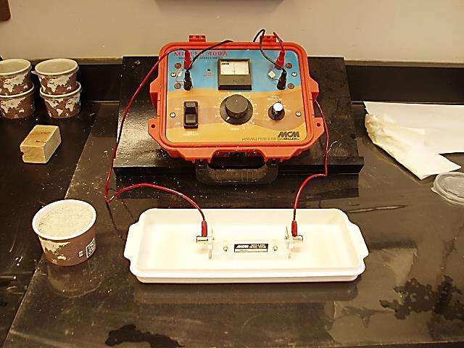
Two Point Connection

Slide 36
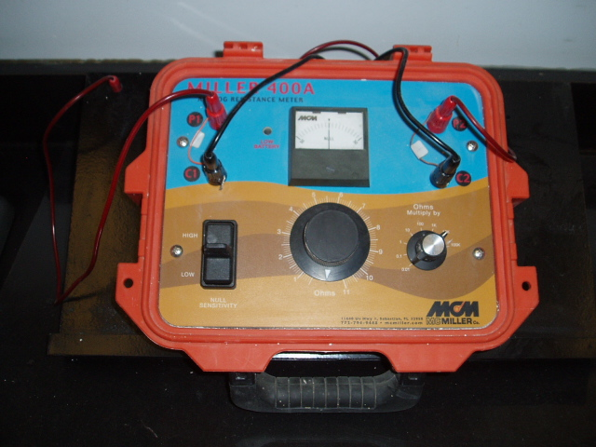
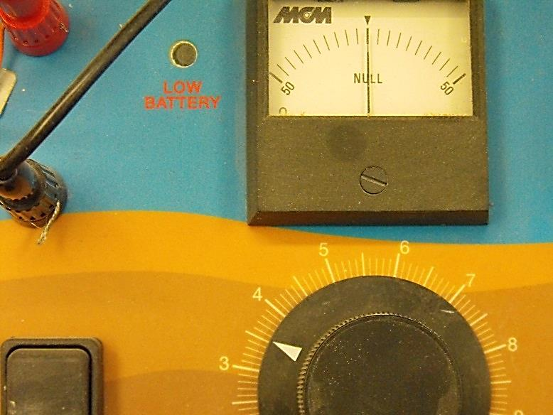
Calibrating the Resistivity Meter
Zero the meter by clamping the two leads together,
and adjusting the meter as necessary.
Connect the leads of the meter to the 100Ώ resistor
and read the meter.
Repeat the process with the 200, 500, and 900Ώ resistors.
If the resistance meter readings are with in 10 percent of that
Of the resistor, the meter is functioning satisfactorily.
This is the MCM Miller 400A Meter
Notes:
Follow your User’s Manual to calibrate your meter this way.

Slide 37
Resistivity Procedure
14 STEPS
Obtain ~1500 grams of the soil passing the No. 10 sieve.
Add 150ml of distilled or DI water to the soil.
Mix thoroughly with non-corrosive equipment.
Cover the mix in a plastic container and allow it to cure
at least 12 hours.
Next day, zero the meter per the manufacturer’s instructions.
Place the sample in the Soil Box in layers and moderately compact. (you can use your fingers)
7. Trim off the excess material with a straight edge.
8. Hook up Soil Box with sample to the Resistance Meter.
9. Measure the resistance. (see manufacturer’s instructions)
10. Calculate and Record the result.
11. Remove the soil from the Soil Box and place it in the mixing bowl.
12. Clean the Soil Box with Di water.
13. Add 100 mL of distilled water to the sample and mix thoroughly.
14. Repeat steps 6 through 13 until a minimum value can be
determined.
Notes:
Clean the soil box with DI water before adding the sample.

Slide 38
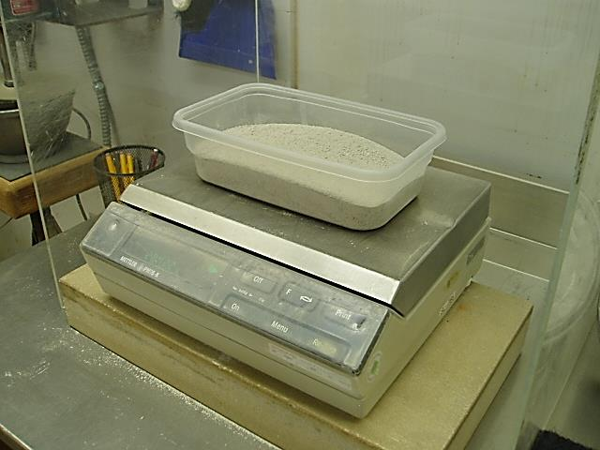
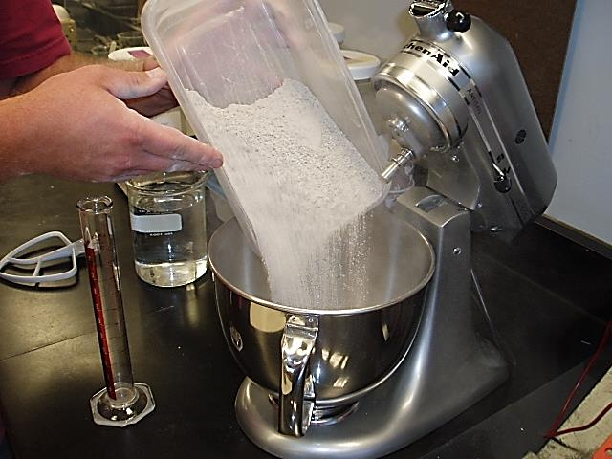
STEP 1.
Obtain ~1500 grams of Soil passing the No. 10 sieve.
1500

Slide 39
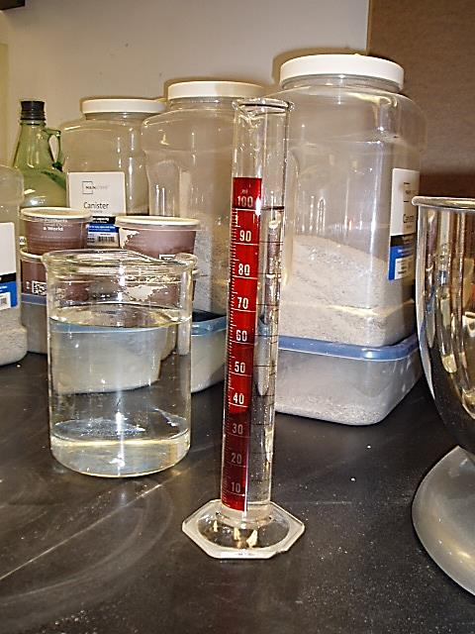
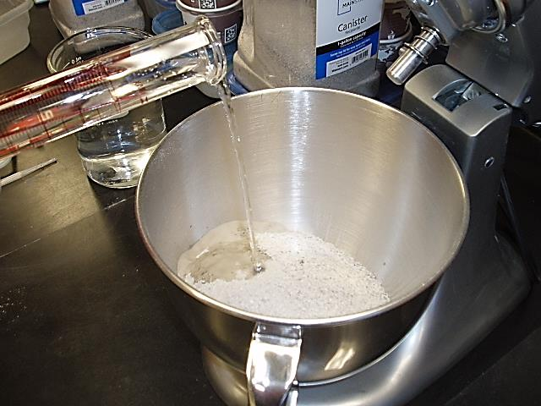
STEP 2.
Add 150ml of distilled or DI water to the soil.
150 ml
150

Slide 40
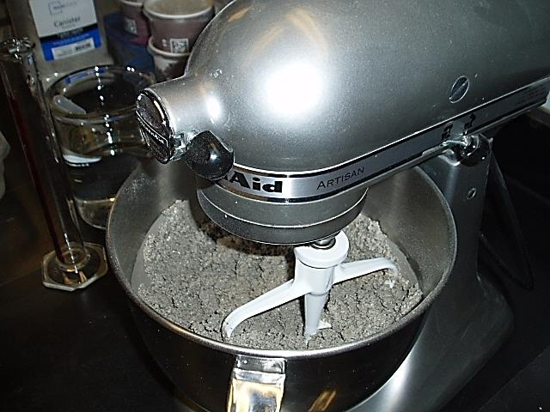
STEP 3.
Mix thoroughly with non-corrosive equipment

Slide 41
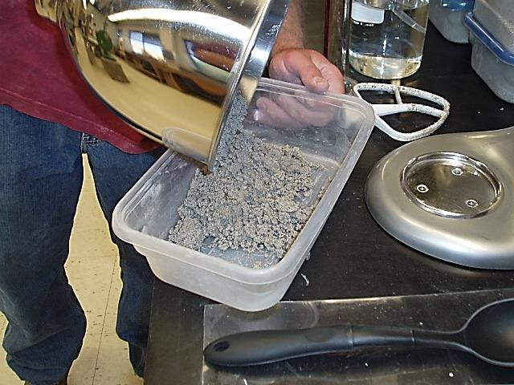
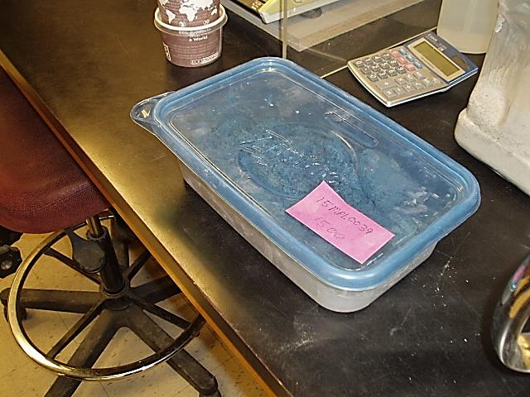
STEP 4.
Cover the mix in a plastic container
and allow it to cure at least 12 hours
Allow to cure 12 hours

Slide 42
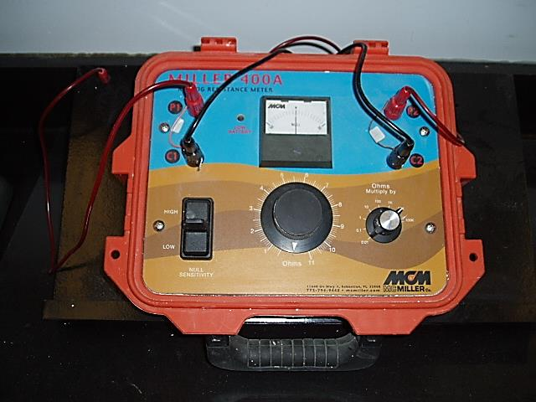
STEP 5.
Next day, zero the meter per the manufacturer’s instructions.
0
I

Slide 43
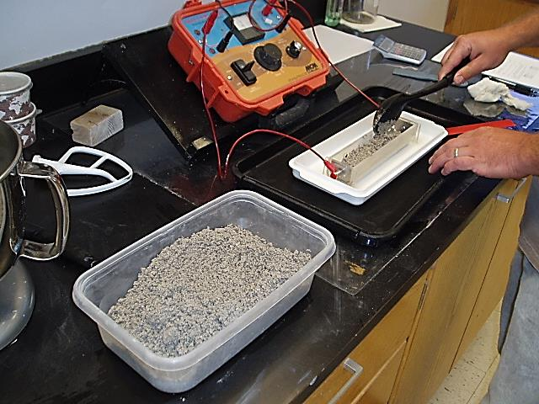
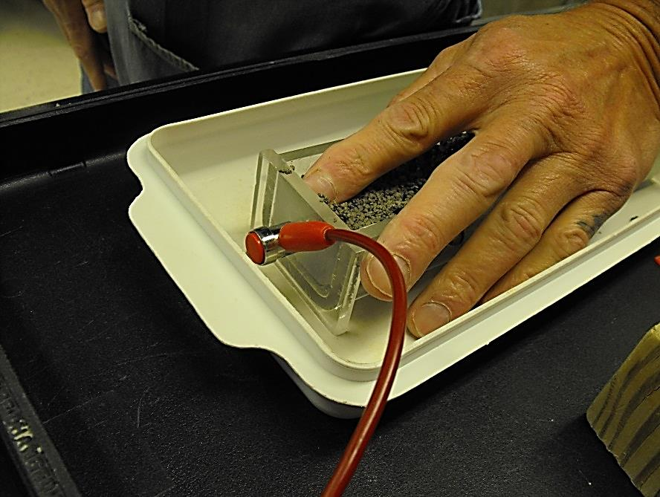
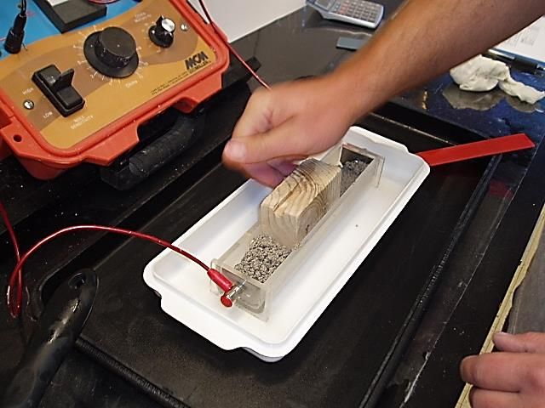
STEP 6.
Place the sample in the Soil box
in layers and moderately compact.
(you can use your fingers)
Compacting
Notes:
You can use your fingers, and as water is added you may eventually end up pouring right out of the mixing bowl.
MODOT: We use a piece of wood for a compacting tool.
You can use as many layers as needed to do the compacting.

Slide 44
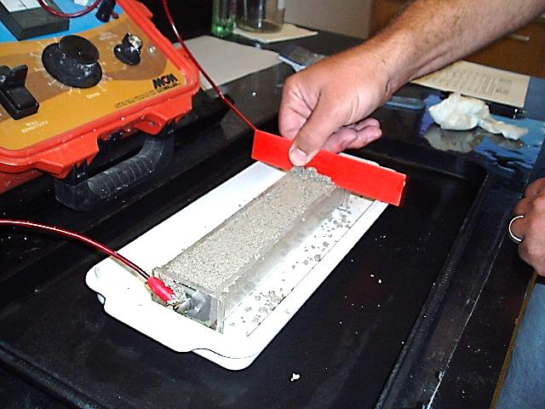
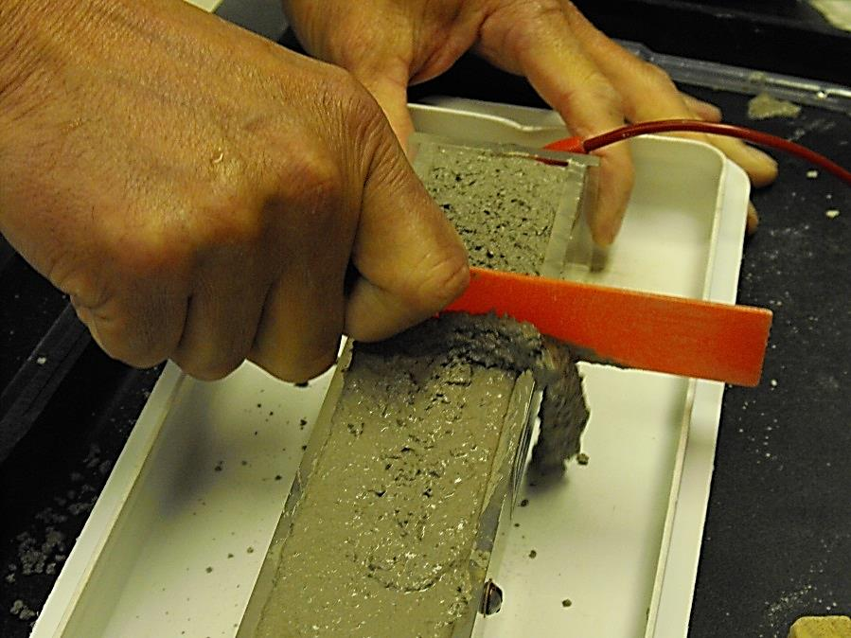
STEP 7.
Trim off the excess material
with a straight edge.
Notes:
The white tray is used to catch the excess material that is trimmed away.

Slide 45
STEP 8.
Hook up the Soil Box with sample
to the Resistance Meter.

Slide 46
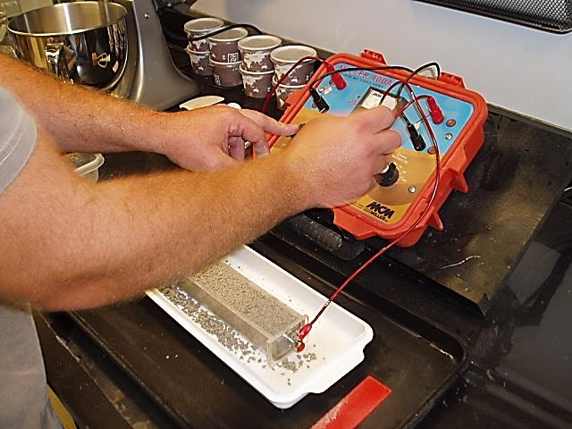
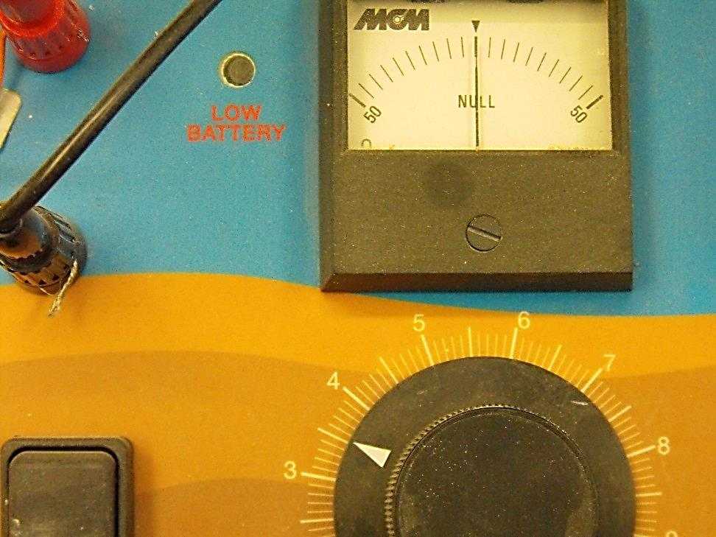
STEP 9.
Measure the resistance.
Adjusting the needle to NULL or T.
Meter is set on 1K
Reading is 3.5
4
3
Notes:
Sometimes you may have to adjust the settings from 1K to 10K accordingly.
In this picture the needle was adjusted to read NULL or “T” turning the black knob to 3.5, and the setting was on 1K.
This Meter is a MC Miller 400D.
See your owners manual for instructions on how to do this.

Slide 47
STEP 10.
Calculate and Record the result.
Multiplier
Notes:
Calculate each result as you go, and remember to use the correct Multiplying Constant for the size soil box you are using.

Slide 48
STEP 11.
Remove the soil from the Soil Box
and place it in the mixing bowl.

Slide 49
STEP 12.
Clean the Soil Box with Di or Distilled Water.
DI Water
Tap Water
Final Wash
Initial Wash
Drying with clean towels
Notes:
We will wash the soil box as well as the overflow tray, using tap water first, then a final rinse in DI water. The reason we wash with Tap water first…is to save on DI water. This extra step is also a good idea for those labs using jugs of Distilled water, this way your water will last for several tests.
Also after rinsing the soil box, we will dry it with a clean paper towel.

Slide 50
STEP 13.
Place the soil in the mixing bowl and mix thoroughly.

Slide 51
STEP 14.
Add 100 mL of DI or Distilled water
to the sample and thoroughly mix
100
100

Slide 52
Minimum Resistivity
Repeat steps 6 through 14 until
a minimum value can be determined.
Lowest reading # 6
Notes:
In this report the 6th reading is the lowest reading because the 7th reading goes back up.
Some samples may require different settings other than 1K… sometimes it’s 10K, then the setting multiplier in the calculation would be 10,000 instead of 1,000.
For instance, lets say for the first reading in this example we needed to set the dial to 10K, then the Measured Ohms would be 330,000 ohms*cm.

Slide 53
Minimum Resistivity
2.9
2.6
Notes:
This is a different example where the lowest reading repeats itself 3 times.
Notice the dial reading 2.9 is the highest reading.
Following this are 3 readings of 2.6.
In this case you would pick reading 6 as your lowest resistivity on your report.

Slide 54
VIEWS OF SAMPLE CONSISTANCIES AFTER EACH
WATER ADDITION.
Notes:
The minimum soil resistivity can occur at any moisture content, in the following slides you will see how the consistency of the soil changes from a moist soil to a slurry…..

Slide 55
After adding 150ml DI water and curing.

Slide 56
After adding another 100ml
total 250ml.

Slide 57
After adding another 100ml
total 350ml.

Slide 58
After adding another 100ml
total 450ml.

Slide 59
After adding another 100ml
total 550ml.

Slide 60
After adding another 100ml
total 650ml.

Slide 61
After adding another 100ml
total 750ml.

Slide 62
RESULTS AND REPORTING
2109
Notes:
NOTE: This is a report of our results with a nice curve of Resistivity verses ml of water added.
Also below are the Chemical Laboratory results on testing pH, Chlorides, Sulfates, and Sulfides.

Slide 63
MoDOT Contacts
Nicole’ Scott
Testing Supervisor – Geotechnical Section
(573) 526-4306
Nicole.Scott@modot.mo.gov
Lydia Brownell
Geotechnical Director
(573) 526-4628
Kevin.McLain@modot.mo.gov
Brett Trautman
Physical Laboratory Director
(573) 751-1036
Brett.Trautman@modot.mo.gov

Slide 64
THE END………………

