Slide 1
Public Input: MetroQuest Survey Report
I-70 planning and environmental linkages (I-70 pel) study
Summer 2017

Slide 2
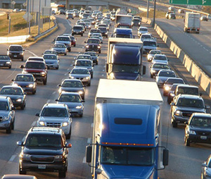
Background
MetroQuest is an online engagement tool, designed to educate and collect useful input from thousands of people. Used by hundreds of cities, government agencies, and public involvement, planning, and engineering firms, MetroQuest was
perfect for engaging with the citizens of the greater St. Louis area in regards to improving I-70, and for collecting and analyzing these responses.
This tool offers a wide range of screen templates to ensure the collection of a variety of data, and allows its users to pick and choose the options that best suit their project. Templates are customized by project to allow the public to rank priorities, respond to questions, rate images or scenarios, select their preferences for any subject with accompanying visuals, place markers on maps and leave comments, and much more. Once the templates are selected, each screen can be customized according to the needs of the study while retaining its easy-to-use format. All responses are accessible via an online dashboard where public input can be monitored, evaluated, analyzed, and reported.

Slide 3

Methodology
Gathering data with MetroQuest online survey tool
The PEL consulting team initially met to discuss what was knowable from the public and how to best request that information via MetroQuest. Content was refined, images selected, and submitted to MoDOT for approval.
The MetroQuest I-70 tool launched in February 2017 and ran for a consecutive 90 days, ending on May 24, 2017. Outreach efforts included: traditional media (press release), social media, the project website, newsletter content shared with stakeholders, social content shared with stakeholders, fliers (see image) at local public libraries, and a public meeting.
The following report details the content of the tool, the data and findings and key comments from our public.
A demonstration of the site can be seen by visiting: https://i70r-demo.metroquest.com.

Slide 4
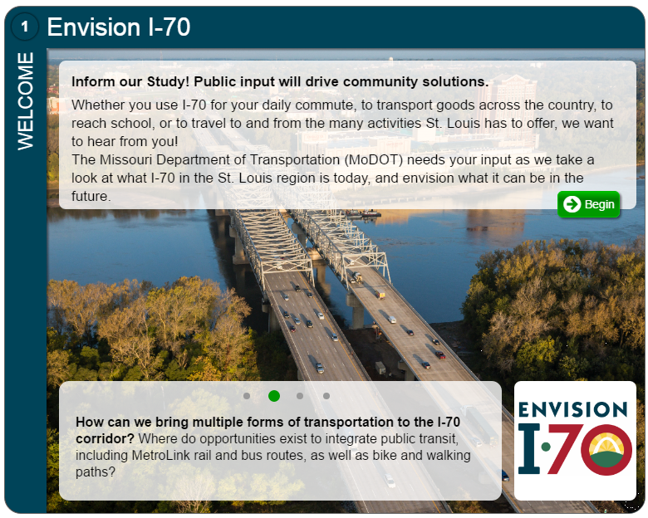
Screen 1: welcome

Slide 5
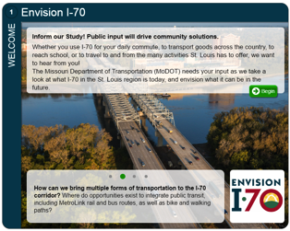
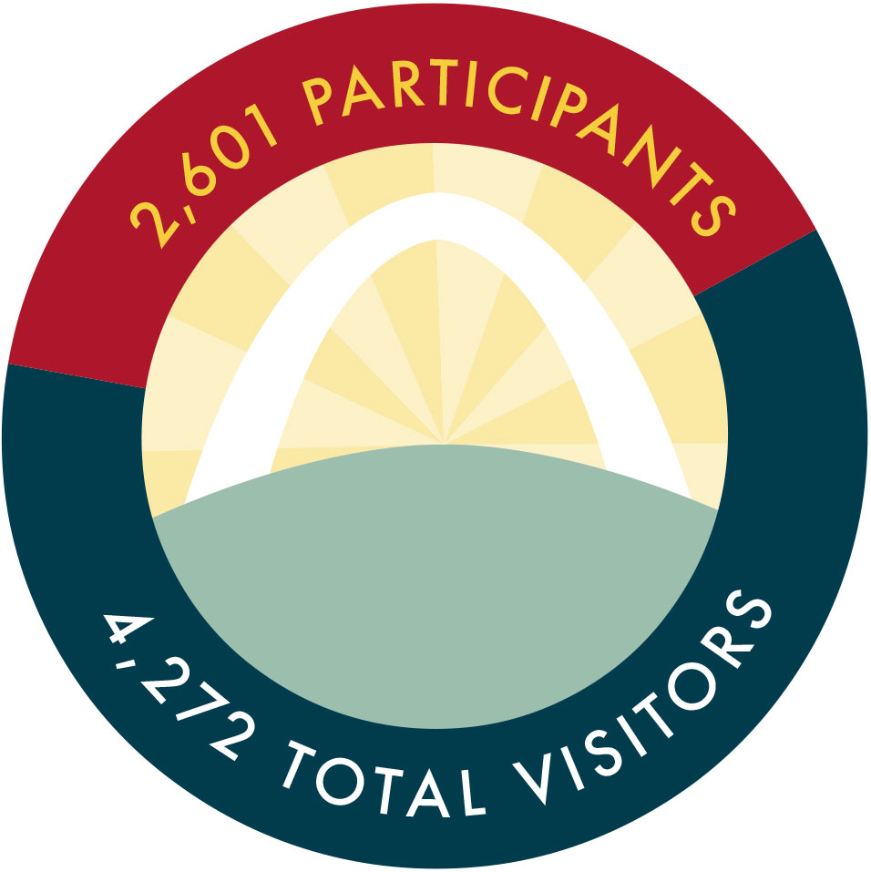
Welcome Screen – Visitors and Participants
From more than 4,200 total visitors we received more than 2600 completed surveys. We know from empirical feedback that the site generated some buzz that had people going back and opening the survey again, which may account for the difference in numbers.
A total of 2601 individual participants was considered a success by the project team.

Slide 6
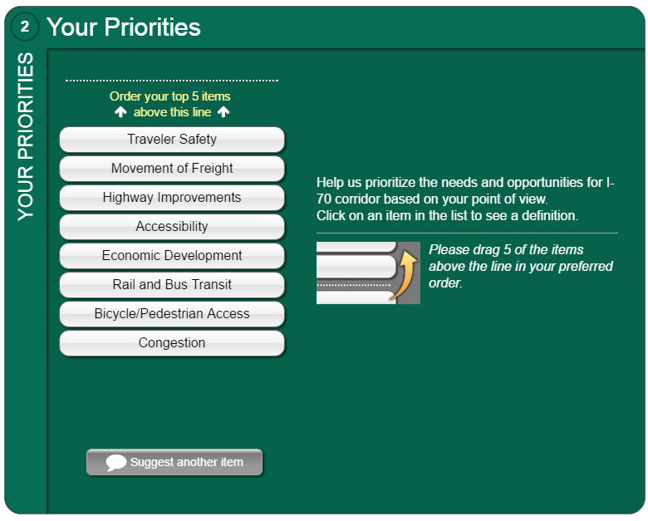
Screen 2: YOUR PRIORITIES

Slide 7
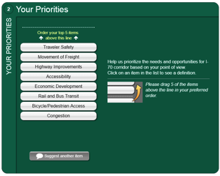
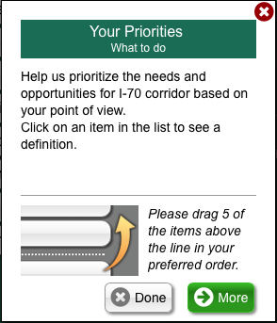
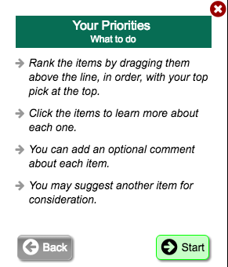
Screen 2 Instructions
Participants were asked to prioritize 5 of 8 possible needs/opportunities

Slide 8
Your Priorities
DEFINITIONS
Congestion: I want the study team to focus on transportation projects that reduce congestion in the region.
Traveler Safety: I want the study team to focus on transportation projects that reduce the number of lives lost and injuries sustained on the region’s roads.
Highway Improvements: I want the study team to focus on improvements such as removing curves and hills, and utilizing express lands for existing roadways.
Rail and Bus Transit: I want the study team to focus on expanding existing transit (both bus and rail) service within the region.
Accessibility: I want the study team to focus on transportation projects that support the ease and efficiency of accessing all the places you want to go.
Bicycle/Pedestrian Access: I support the regional plans to improve access for bike and pedestrians throughout the corridor.
Economic Development: I want the study team to focus on transportation projects that support the development and attraction of new jobs and businesses within the region, which would in turn support community vitality.
Movement of Freight: I want the study team to focus on transportation projects that support the movement of freight throughout the region.

Slide 9
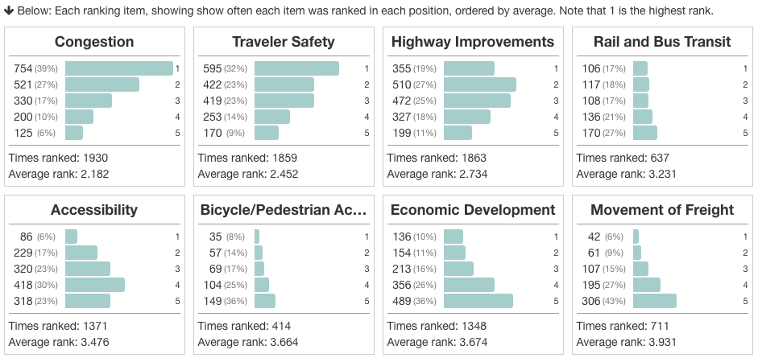
Your Priorities – How often each was ranked
Congestion, traveler safety and highway improvements not only received the most rankings, they had the highest average ranking. Notable: Economic Development and Accessibility were ranked by more than half the responders, just at a lower level of importance.

Slide 10
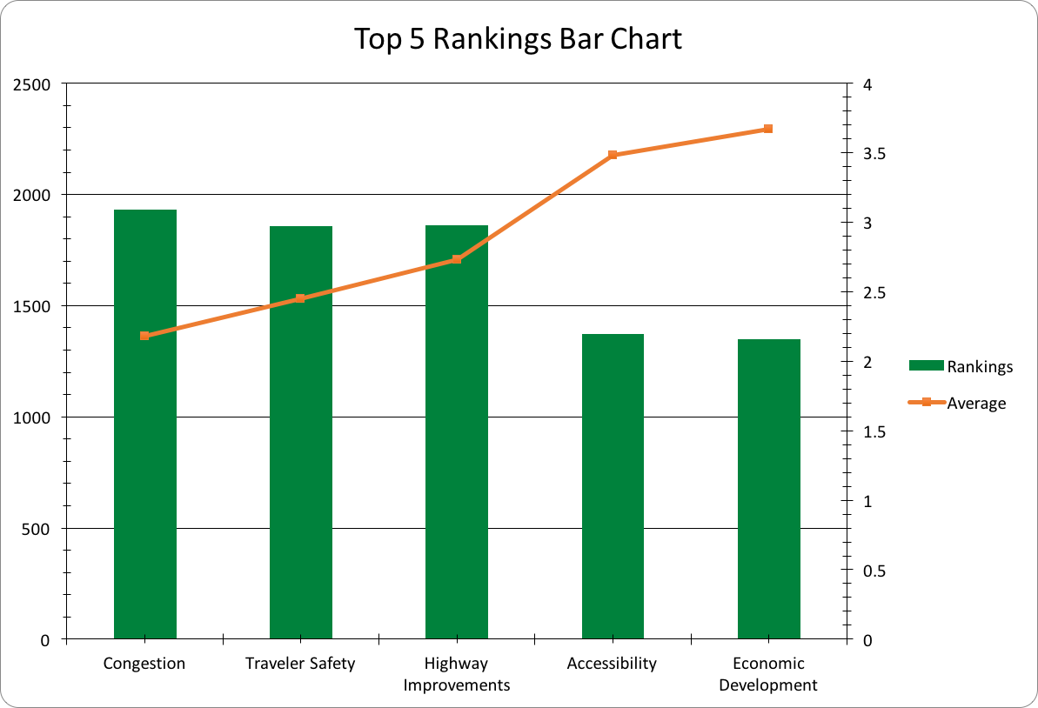
Your Priorities – Distributions
Filter #1: Popularity. The vertical bar chart shows the top five rankings from participants.
Filter #2: Rankings. The orange line shows the average rankings as people sorted their top five choices.

Slide 11
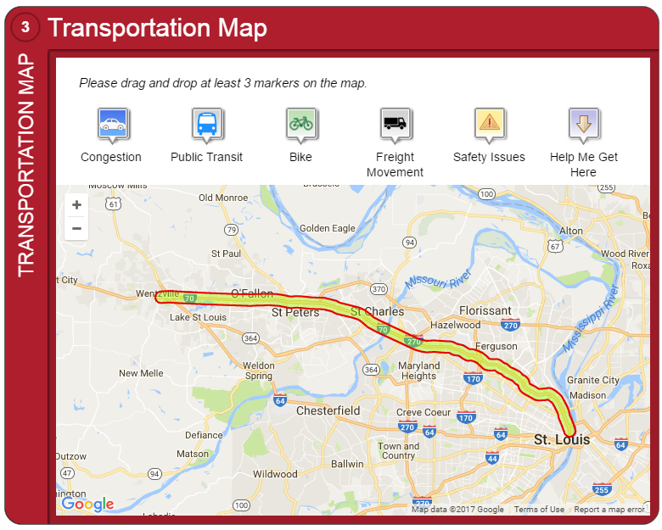
Screen 3: transportation map

Slide 12
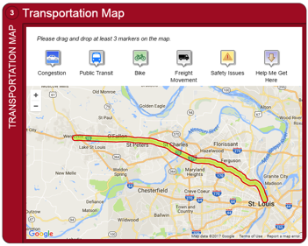
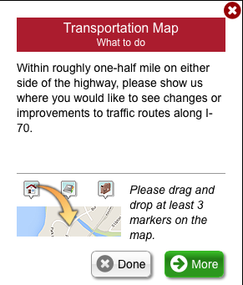
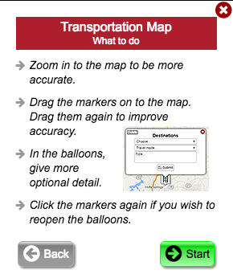
Transportation Map – Instructions
Participants were asked to drop markers on map to show where improvements need to be made

Slide 13
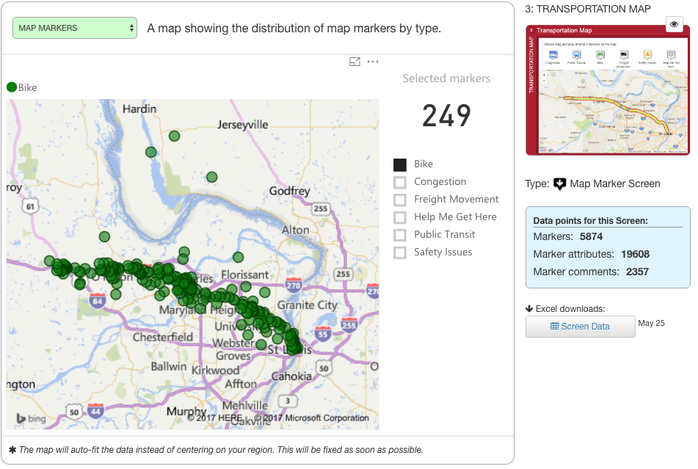
Transportation Map Markers – Bike

Slide 14
Marker Data and Comments – Bike
When the Bike marker was chosen, participants were asked, “What would you like to see here?”
A dropdown menu appeared, and participant could choose to add a marker without tagging it,
or tag it with one of the following choices:
Choices given with number of responses:
• Add Bike Lane: 38
• Add Bike Trail: 39
• Improve Bike Lane or Trail: 2
249 total markers / 102 comments

Slide 15
Summary of Key Comments – Bike
Need more signage/wayfinding along the regional trail
Bike lane(s) to get across Missouri River
More ways to travel between St. Charles and St. Louis County on bike
Connect Katy Trail to Earth City Levee, UMSL (similar to Page extension)
Bike crossings at Cave Springs, Zumbehl
Improve bike crossings
  i.e. crossing I-70 on Lindbergh
Bike access from St. St. St. Charles to Riverport
Better access points for bikes to safely cross over/under the interstate

Slide 16
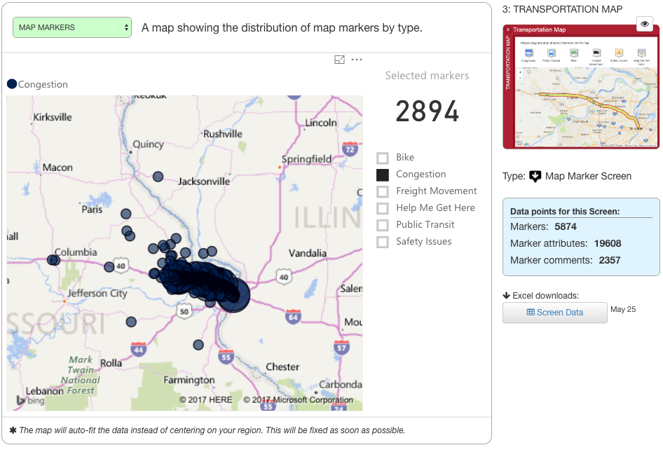
Transportation Map – Congestion

Slide 17
Marker Data and Comments – Congestion
When the Congestion marker was chosen, participants were asked, “What type of congestion?”
A dropdown menu appeared, and participant could choose to add a marker without tagging it,
or tag it with one of the following choices:
Choices given with number of responses:
2,894 total markers / 966 comments
• East morning rush: 278
• West morning rush: 39
• East evening rush: 73
• West evening rush: 538
• Truck Traffic: 51
• Event Traffic: 37

Slide 18
Summary of Key Comments – Congestion
Add HOV lanes
Increase number of lanes
  From 370 to 1st Capitol
  From Highway Z to Wentzville
  Through Wentzville to Warrenton
  Between Zumbehl and Cave Springs
  Highway K and Bryan Rd.
Widen/fix “S” curve railroad underpass
Church St. should not go from 3 lanes down to 2
More signs for exit only lanes
Problematic entrance and exit ramps from 270 to 70
  Extend right lane to St. Charles Rock Road
Improve 64/70 interchange
  More lanes
Entrance/exit ramps
  Longer entrance from Cave Springs
  Additional exit lanes getting off 70
Additional exits
  North/South Pointe Rd.
  Woodson Rd.

Slide 19
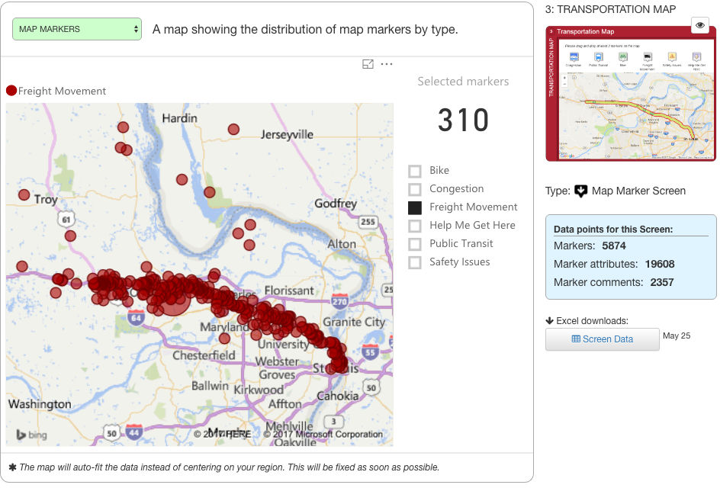
Transportation Map – Freight Movement

Slide 20
Marker Data, Comments – Freight and Movement
When the Freight and Movement marker was chosen, participants were asked, “What would you like to see here?”
A dropdown menu appeared, and participant could choose to add a marker without tagging it,
or tag it with one of the following choices:
Choices given with number of responses:
• Delays in Movement: 18
• Need Alternative Route: 39
• Improve Access: 33
• Intermodal Connections: 20
310 total markers / 112 comments

Slide 21
Summary of Key Comments – Freight Movement
Dedicated lanes for trucks/other heavy vehicles between the city limit and St. Charles County
Widen the ramp from SB 61 to EB 70
Remove left lane exits and entrances
Reduce sharpness of ramps
  i.e. NB I-170 to EW I-70 ramp
Create express lanes for semis

Slide 22
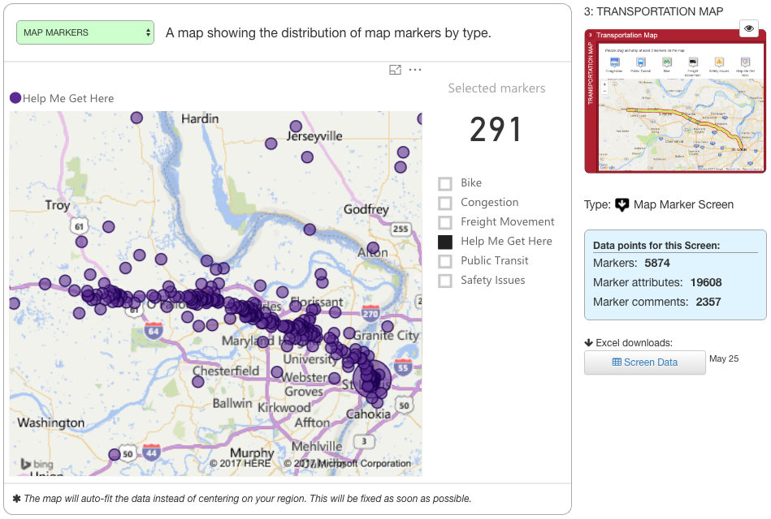
Transportation Map – Help Me Get There

Slide 23
Marker Data, Comments – Help Me Get There
When the Help Me Get There marker was chosen, participants were given the opportunity to make a comment in addition to placing a marker
291 total markers / 161 comments

Slide 24
Summary of Key Comments – Help Me Get There
Improve airport access
Improve signage for downtown exits
Need pedestrian access from airport/MetroLink to the other side of I-70
Tucker from I-70 West
Better transportation to Florissant Valley Community College
Confusing interchanges
  US 61, Pitman Ave., Pearce Blvd., I-70
  Broadway, Cole, I-70
Straighten out I-70 at Wentzville
Extend ramp to and from Wentzville Parkway
Make I-70 three lanes until Foristel

Slide 25
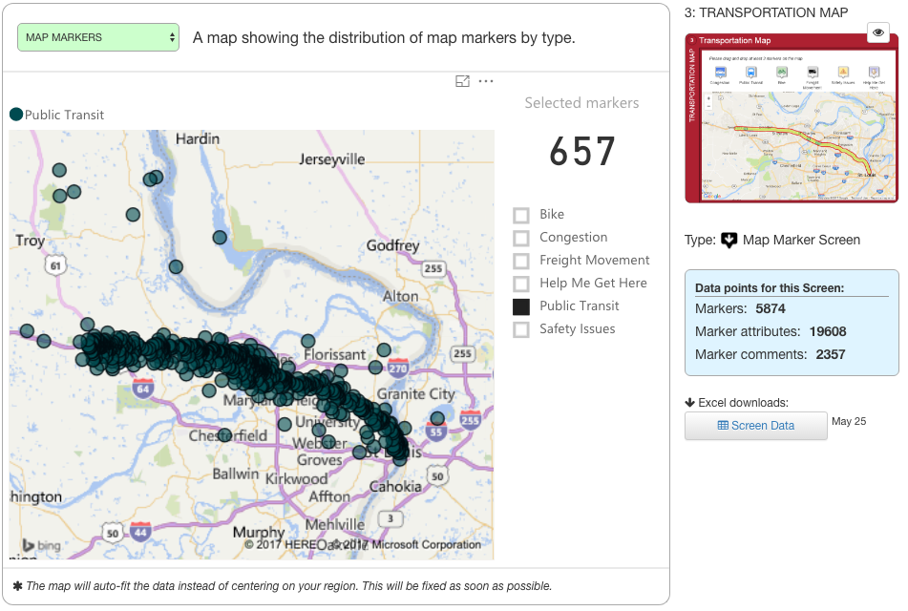
Transportation Map – Public Transit

Slide 26
Marker Data and Comments – Public Transit
When the Public Transit marker was chosen, participants were asked, “What would you like to see here?”
A dropdown menu appeared, and participant could choose to add a marker without tagging it, or tag it with one of the following choices:
Choices given with number of responses:
• Add Bus Stop: 7
• Add Bus Service: 38
• Enhance Bus Service: 13
• Add Rail Service: 187
• Enhance Rail Service: 15
657 total markers / 287 comments

Slide 27
Summary of Key Comments – Public Transit
Better public transit from N. Hanley to St. Charles county
Public transit from 1st Capitol or Fifth Street into the Hanley Metro station
Extend MetroLink to St. Charles
  Stop at DePaul hospital
  Stop at Maryland Heights
Connect rail to STL International Airport red line
Rail going south along Lindbergh
Express rail for those commuting to the city every day
Extend MetroLink to Wentzville and Lake St. Louis

Slide 28
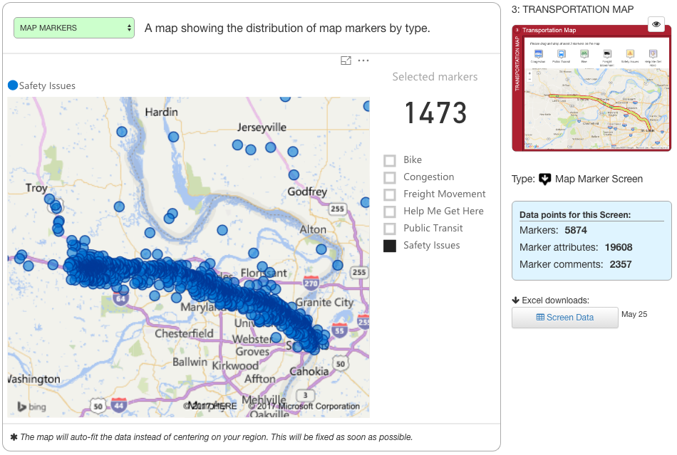
Transportation Map – Safety Issues

Slide 29
Marker Data and Comments – Safety Issues
When the Safety Issues marker was chosen, participants were asked, “What type of safety issue?”
A dropdown menu appeared, and participant could choose to add a marker without tagging it,
or tag it with one of the following choices:
Choices given with number of responses:
1,473 total markers / 729 comments
• Truck Traffic: 44
• Speeding: 78
• Frequent Accidents: 184
• Bike/Pedestrian Conflict: 9
• Ramp Backups: 121
• Poor Sight Distance: 75

Slide 30
Summary of Key Comments – Safety Issues
Signage to identify lanes moving from I-70 to I-270 should be directly over the lane needed for finding the desired exit
“S” curve under the railroad overpass: too narrow, straighten out
Lengthen on/off ramps
Mid-Rivers Mall interchange
  At grade stop at traffic lights
  Difficult to maneuver
I-70 and I-170
  Dangerous to exit E 70 and enter on N 170 on fast lanes
  East 70 drivers need to be warned of merging traffic in right lane from 170
SR79
  No light at NB exit ramp for SR79
  Blind spot for left turns due to EB 70 blocking visibility to SB SR79 traffic
Widen I-70 past Wentzville Parkway
On/off ramps getting onto I-70 from NB Maryland Heights/Earth City expressway
I-70 narrowing to two lanes after Broadway
Longer merge lane b/w Natural Bridge/Cypress and the current Lindbergh exit
More signage to indicate the right lane heading WB is exit only onto 40/61
Wentzville Parkway
  Exit only lane from I-70W
  Add another lane on ramp from Wentzville Pkwy to I-70E

Slide 31
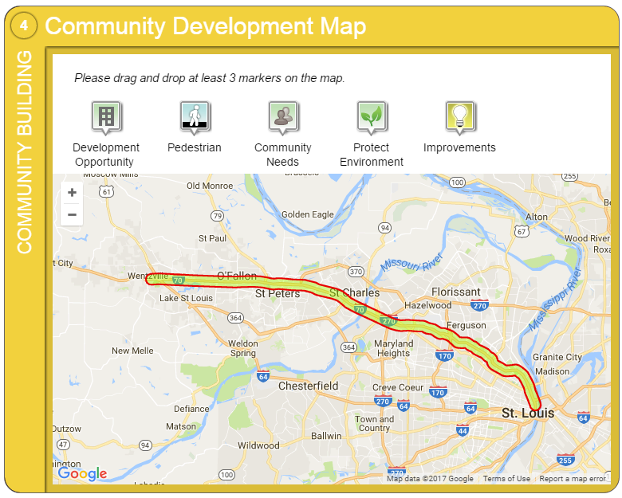
Screen 4: Community Development

Slide 32
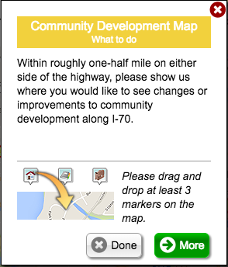
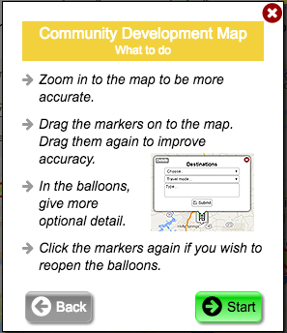
Community Development Map – Instructions
Participants were asked to drop markers on map to show where they would like to see changes or improvements to the community along I-70

Slide 33
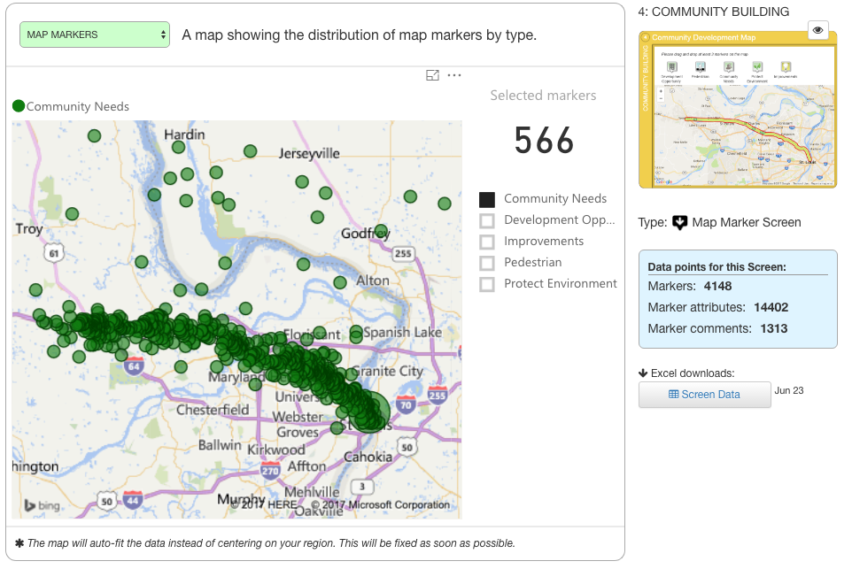
Community Development Map Markers – Community Needs

Slide 34
Marker Data and Comments – Community Needs
When the Community Needs marker was chosen, a dropdown menu appeared with a number of choices
Participant could choose to add a marker without tagging it, or tag it with one of the following choices:
Choices given with number of responses:
• Connections to Services: 65
• Connections to Businesses/Jobs: 49
• Connections to Neighborhoods: 48
• Connections to Shopping/Dining: 79
566 total markers / 154 comments

Slide 35
Summary of Key Comments –
Community Needs
Programs to sustain local communities instead of emphasizing support for outside people coming in
Expand MetroLink
Bus service to connect St. Charles to St. Louis
Make exits to service roads between Zumbehl and Mid Rivers for easier access to businesses
Create local access roads alongside the expressway
Create overpasses in Wentzville to connect south and north sides and alleviate congestion on Parkway overpass
Update Highway K interchange
Build bridge at North/South Pointe Prairie

Slide 36
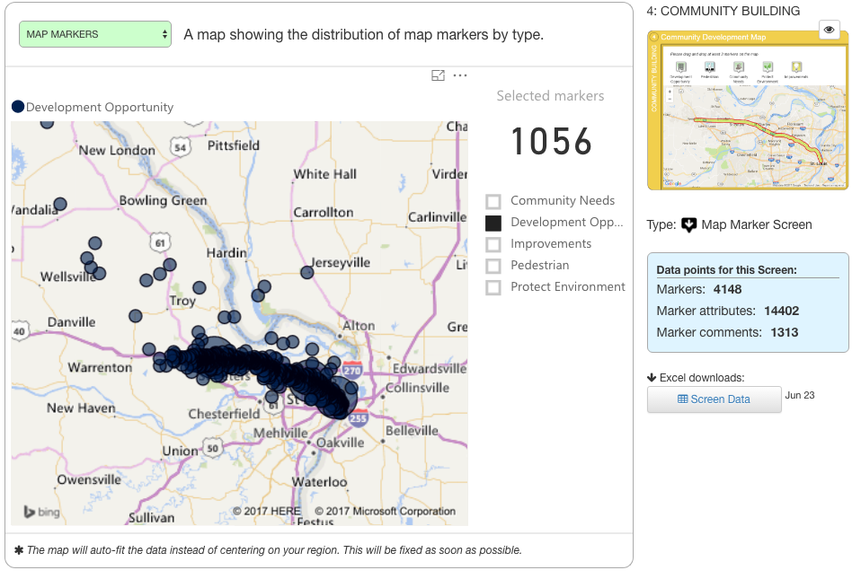
Community Development Map Markers – Development Opportunity

Slide 37
Marker Data and Comments –
Development Opportunity
When the Development Opportunity marker was chosen, a dropdown menu appeared with a number of choices
Participant could choose to add a marker without tagging it, or tag it with one of the following choices:
Choices given with number of responses:
• Current Development Site: 53
• Future Development Site: 122
• Redevelopment Site: 170
• Underutilized Site: 182
• Other (Please specify): 27
1,056 total markers / 349 comments

Slide 38
Summary of Key Comments –
Development Opportunity
Pay attention to underserved/underutilized communities along I-70
Neighborhoods bordering interstate from airport to downtown are struggling
Develop retail at Hanley MetroLink station
Better access to outer roads for business and future development
Open space near Hwy DD/Winghaven off I-70
Second and/or expanded overpass to alleviate congestion from Pierce overpass
Easier access to the airport and surrounding community/businesses
Complete overpass at Pointe Prairie Rd
Tear down vacant properties
Build more sit-down restaurants along corridor between downtown and airport
Develop on south side of I-70 b/w TR Hughes and Hwy K

Slide 39
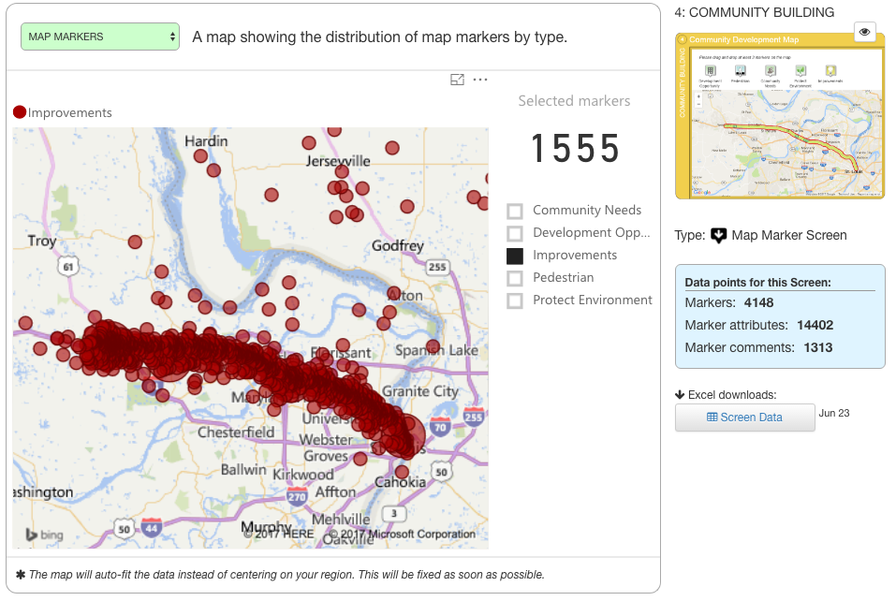
Community Development Map Markers – Improvements

Slide 40
Marker Data and Comments –
Improvements
When the Improvements marker was chosen, a dropdown menu appeared with a number of choices
Participant could choose to add a marker without tagging it, or tag it with one of the following choices:
Choices given with number of responses:
• Fix Pavement: 129
• Fix Interchange: 391
• Remove Hill: 23
• Decrease Curve: 138
1,555 total markers / 489 comments

Slide 41
Summary of Key Comments –
Improvements
Improve I-70 to I-270 interchange
Improve 70 and 94 interchange, more effective signage
Fix “S” curve under railroad overpass
Redo paving between I-70E Salisbury exit to I-70 exit at 11th and Destrehan
Improve Cave Springs interchange
Improve I-70/I-270/St. Charles Rock Rd interchange
Improve Hwy 79 interchange
Exit ramp from Spencer Rd. to I-70E
Exit ramp on Pointe Prairie
Additional lanes from Wentzville to Warrenton
Add exit between Wentzville and Foristell
Create more accident pull-offs

Slide 42
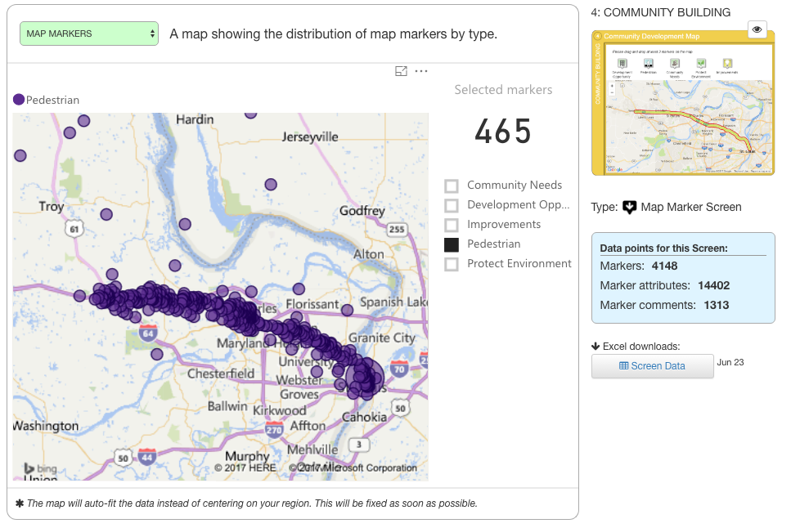
Community Development Map Markers – Pedestrian

Slide 43
Marker Data and Comments –
Pedestrian
When the Pedestrian marker was chosen, a dropdown menu appeared with a number of choices
Participant could choose to add a marker without tagging it, or tag it with one of the following choices:
Choices given with number of responses:
• New Sidewalk: 34
• Improve Sidewalk: 32
• Add Walking Trail: 51
• Improve Walking Trail: 9
• Add Pedestrian Bridge: 115
465 total markers / 156 comments

Slide 44
Summary of Key Comments –
Pedestrian
Pedestrian connectivity from N. Hanley MetroLink station to the north
Pedestrian bridge from Arch North River Outlook to Eads Bridge Walkway
Pedestrian bridge across river
Better N/S access for pedestrians on Hwy K and M beneath I-70
Connect Great Rivers Greenway and Dardenne Greenway trail across I-70
Multi-use trail connecting O’Fallon, Penrose Parks and Bellefontaine Cemetery
Add trail/bridge from Earth City area to Riverport
Add pedestrian bridge between Lucas and Hunt and Goodfellow
Pedestrian bridge from airport terminals to parking lots, hotels, etc. on other side of I-70
Pedestrian/bike lane on Blanchette bridge
Pedestrian bridge/lane from Florissant Rd to Bermuda Rd
Sidewalk/bridge at I-70 and Hwy K
Access to Bluffs area/Quail Ridge park from I-70 and Hwy Z

Slide 45
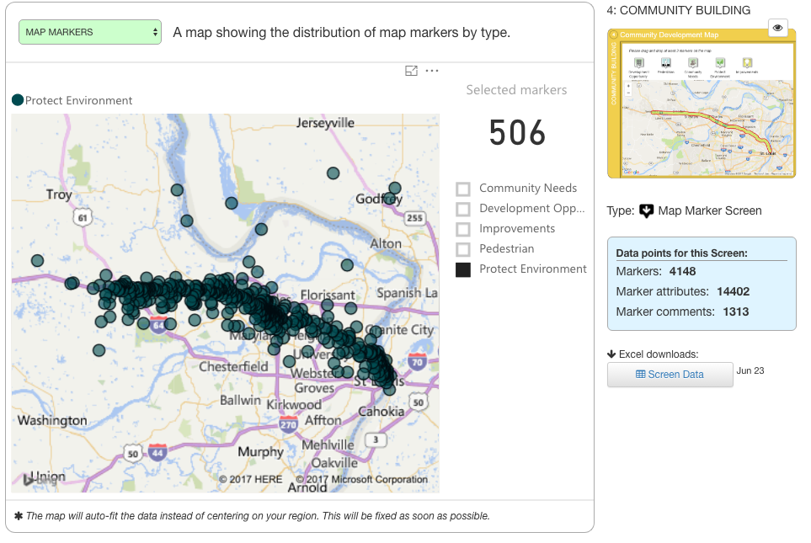
Community Development Map Markers –
Protect Environment

Slide 46
Marker Data and Comments –
Protect Environment
When the Protect Environment marker was chosen, a dropdown menu appeared with a number of choices
Participant could choose to add a marker without tagging it, or tag it with one of the following choices:
Choices given with number of responses:
• Green Space: 106
• Water Resources: 43
• Historical Landmark: 13
• Ecosystems: 76
506 total markers / 165 comments

Slide 47
Summary of Key Comments –
Protect Environment
Protect the few green spaces that currently exist
Plant more trees along highway
Add plantings/foliage/flowers along highway
Plant trees in open space around I-70 and 370 interchange
Fix trash from Lucas & Hunt flowing into community pond via storm sewers
Stop building in/polluting floodplain
Lots of concerns about burning landfill near the nuclear plant
  Smell, in particular

Slide 48
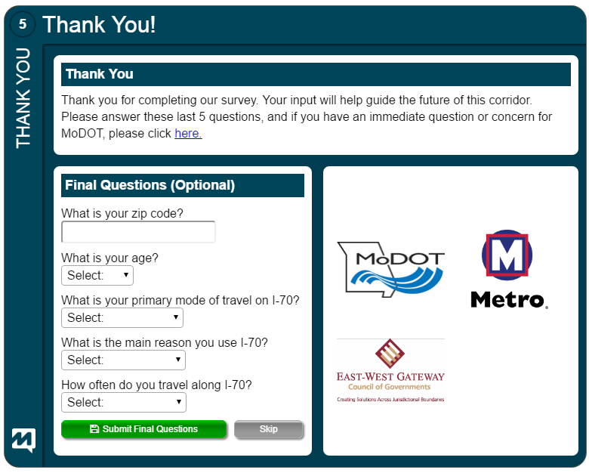
Screen 5: Thank you (Demographics)

Slide 49
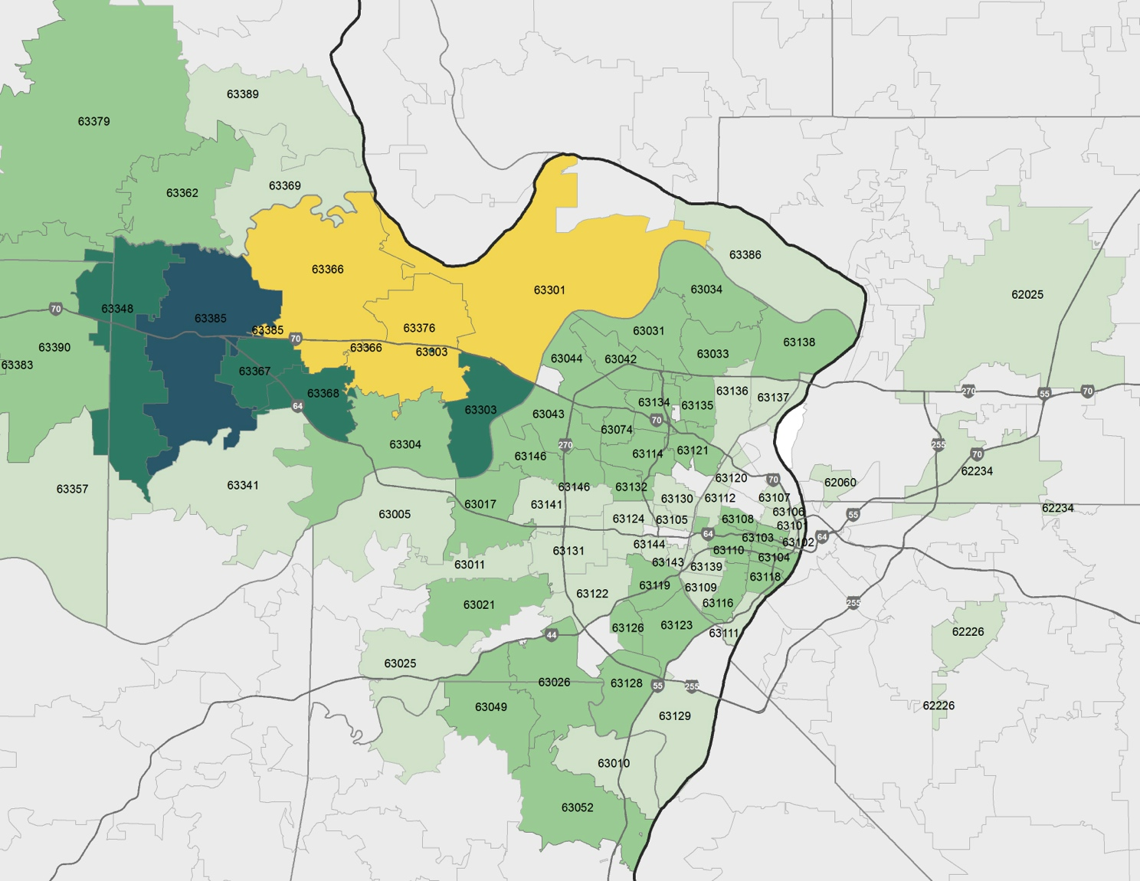

Demographics: Who participated
Participation was gathered from the majority of zip codes in the region, as shown by those opting to respond to this question. Higher numbers in some areas may be influence by comparative population density, by level of encouragement and sharing of data by local stakeholders and by frequency of corridor use.

